Slide 1



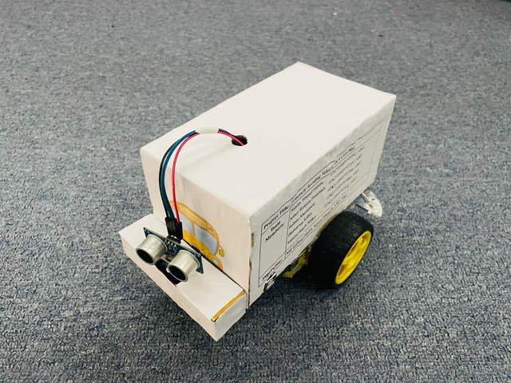
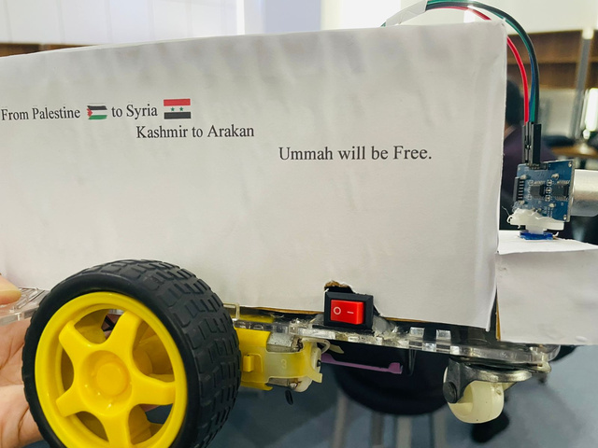
WELCOME
SE-532 PRESENTATION
PROJECT ABOUT
OBSTACLE AVOIDING VEHICLE

Slide 2


SUBMITTED TO
Name: Md Hafizul Imran
Designation: Senior Lecturer
Department Of Software Engineering
Daffodil International University

Slide 3

Name: Sanim Yousuf Fahim
ID : 0242310005341092
Name: Sohan Ahemmed
ID : 0242310005341266
Name: Niher Ronjon Pramanik
ID : 0242310005341102
Name: Humayun Kabir
ID : 0242310005341085
Md .Samiul Islam Saikat
ID : 0242310005341131
ABOUT
Team noNerds

Slide 4
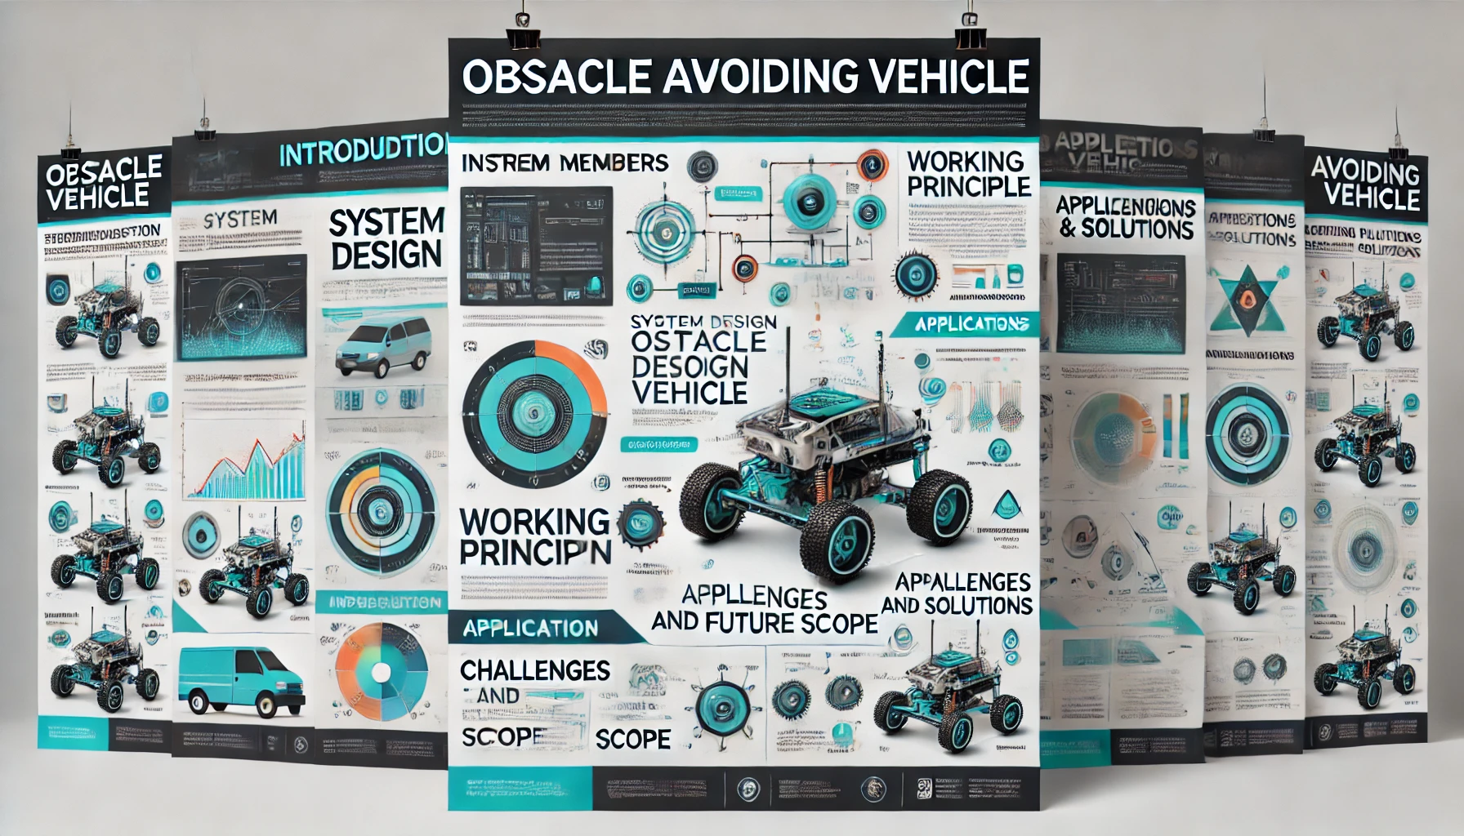


CONTENTS
Introduction
System Design
Working Principle
Applications
Challenges and Solutions
Conclusion and Future Scope

Slide 5


INTRODUCTION
Definition:
An autonomous vehicle capable of detecting and avoiding obstacles in its path without human intervention.
Objective:
Develop a cost-effective and efficient obstacle avoidance system.
Improve the safety and reliability of navigation.

Slide 6
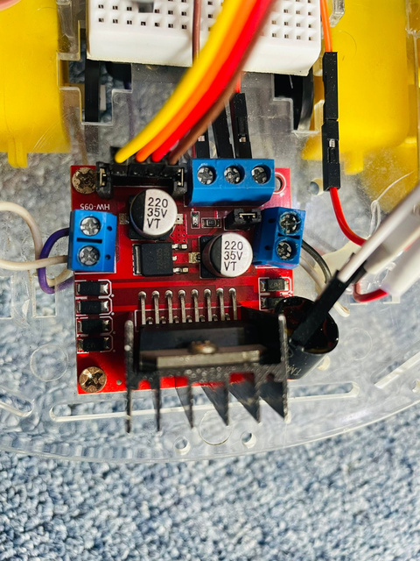
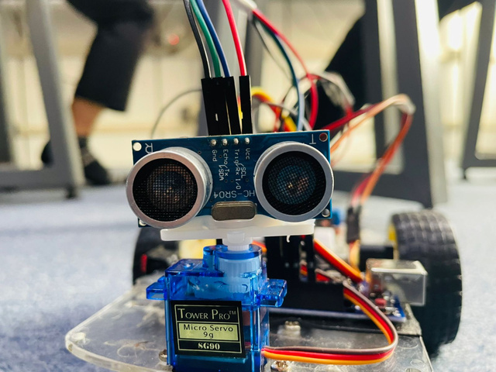
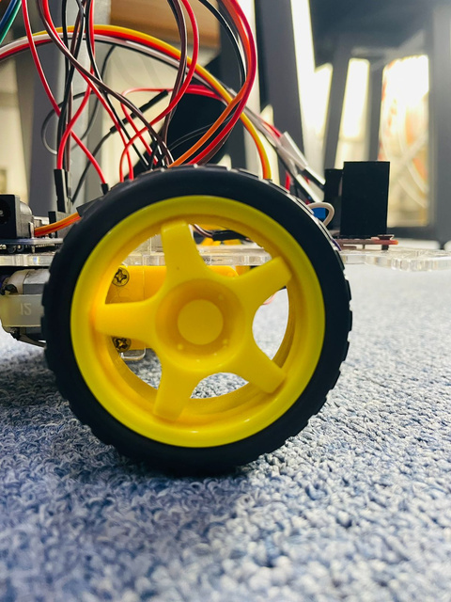
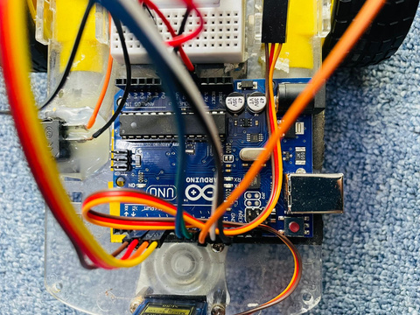
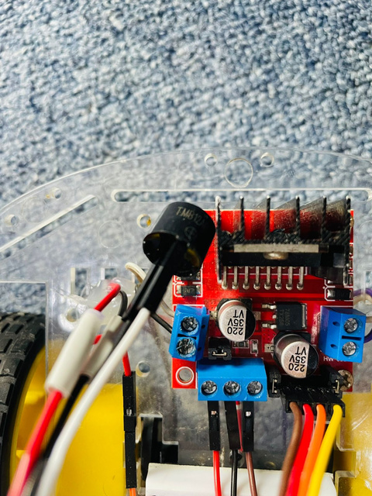
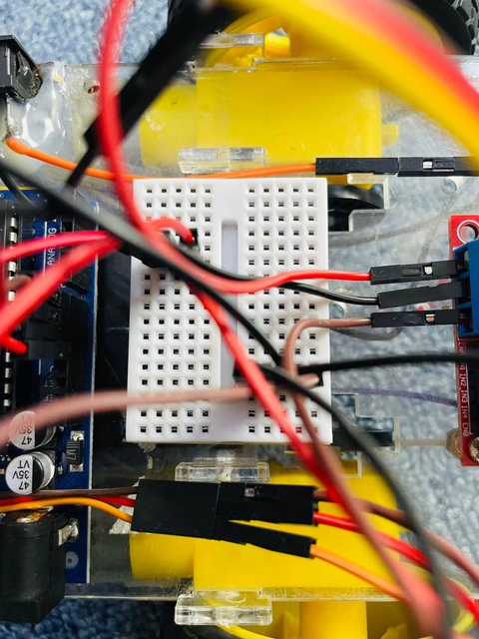
SYSTEM DESIGN
Components Used:
Arduino Uno
Breadboard Mini
Motor Driver Module (L298N)
Ultrasonic Sensor (HC-SR04)
Servo Motor
Jumper Wire
Chassis with 2 wheels
Battery Pack
Switch
DC motor
Buzzer

Slide 7

Obstacle Detection:
Sensors emit ultrasonic waves.
Waves reflect back when hitting an object.
Distance is calculated using the time taken for the wave to return.
Decision-Making:
Microcontroller processes sensor data.
Determines the best path to avoid obstacles.
Vehicle Movement:
Motor driver adjusts motor speed and direction.
The vehicle steers around the obstacle.
WORKING
PRINCIPLE

Slide 8
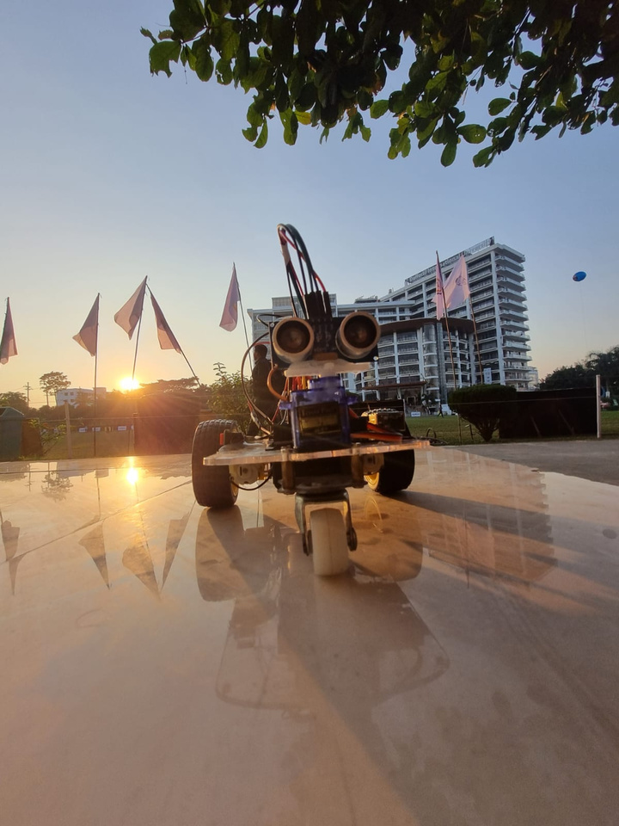
APPLICATIONS
Autonomous Cars
For self-driving capabilities.
Industrial Robots
Navigation in factories or warehouses.
Delivery Drones
Efficiently avoid obstacles in crowded spaces.
Search and Rescue
Aid in disaster recovery by maneuvering through debris.

Slide 9
CHALLENGES AND SOLUTIONS
Sensor Limitations
Smooth Navigation
Power Efficiency
Challenge
Limited range and accuracy of sensors.
Solution
Used multiple sensors for better coverage.
Challenge
Ensuring smooth steering and speed control.
Solution
Calibrated motor responses with fine-tuning algorithms.
Challenge
Optimizing battery life for prolonged operation.
Solution
Implemented low-power modes in the system.

Slide 10
CONCLUSION
Our Obstacle Avoiding Vehicle is a simple and effective project that can move on its own by avoiding obstacles using sensors and a microcontroller. It has uses in areas like transportation and robotics. We faced some challenges, like making the sensors and motors work perfectly, but we overcame them. In the future, we can improve it with better technologies like GPS or advanced sensors.

Slide 11


SOURCE CODE
Source_Code_Link
TUTORIAL
Tutorial_Link

Slide 12





REFERANCES
WWW.GOOGLE.COM
Wikipedia.com
Youtube.com
CHATGPT.COM

Slide 13
THANK YOU

